Slide 1

Monitoring and Troubleshooting
WSO2 Identity Server Advanced

Slide 2
WSO2 Identity Server Logs
Logs are vital for identifying errors, security threats, and usage patterns.
WSO2 Identity Server ships with Apache log4j2.
Users can configure logging levels for each type of activity or transaction.
All log files can be viewed from the <IS_HOME>/repository/logs folder.

Slide 3
Log Types

Slide 4
Carbon Logs
Covers all the management features of a product.
Logs related to the Carbon framework
Carbon logs are used to
Debug errors and exceptions.
Identify performance issues.
Troubleshoot connectivity issues of WSO2 Identity Server.
Written to wso2carbon.log file in the <IS_HOME>/repository/logs directory.

Slide 5
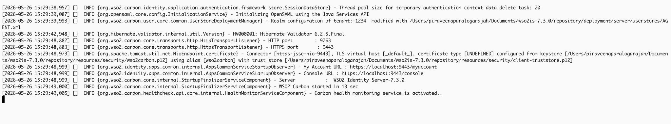
Carbon Logs

Slide 6
Audit Logs
Tracks the sequence of actions that affect a particular task carried out on the server.
Logs related to user activity and system activity.
Audit logs include
  user activities.
  administrative activities.
  system activities.
Written to audit.log file in the <IS_HOME>/repository/logs directory.

Slide 7
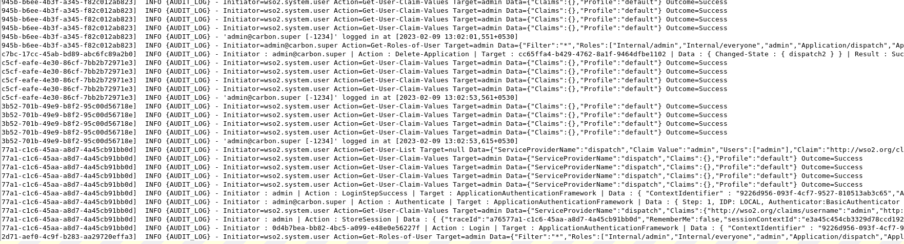
Audit Logs

Slide 8
HTTP Access Logs
HTTP requests/responses are logged to monitor the activities related to an application's usage.
Logs HTTP requests made to the servlet transport.
Servlet transport listens on the 9443 and 9763 ports.
Servlet transport handles incoming requests related to administration and operation
HTTP access logs are used to
  track usage.
  analyze traffic patterns and trends.
  Detect and diagnose errors of web applications.
Written to http_access_.<DATE>.log file in the <IS_HOME>/repository/logs directory.

Slide 9
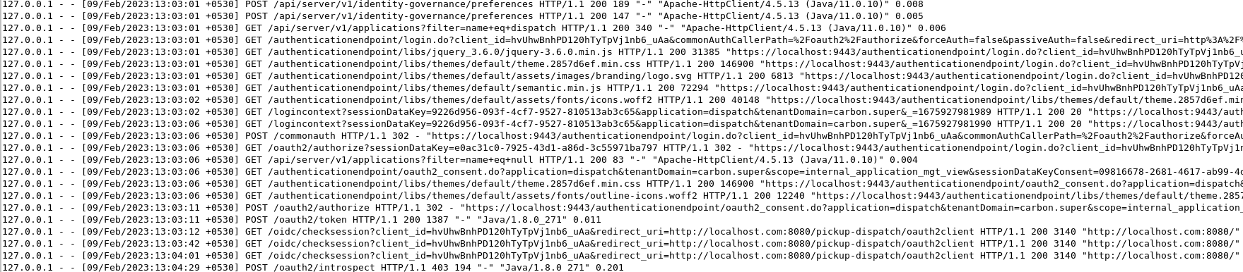
HTTP Access Logs

Slide 10
Configure Logs

Slide 11
Log Levels
OFF | Intended for disabling logging.
FATAL | Indicates server errors that cause premature termination.
ERROR | Indicates other runtime errors or unexpected conditions.
WARN | Indicates the use of deprecated APIs, poor use of API, possible errors, and other runtime situations that are undesirable or unexpected but not necessarily wrong.
INFO | Indicates important runtime events, such as server startup/shutdown.
DEBUG | Provides detailed information on the flow through the system.
TRACE | Provides additional details on the behavior of events and services.

Slide 12
Log Rotation
Mechanism to prevent log files from becoming too large and unmanageable.
WSO2 IS default settings for log rotation:
  Time based triggering policy is 1 day
  Size based triggering policy is 10MB
  Up to 20 backup files
Configurable in the log4j2.properties file in the <IS_HOME>/repository/conf directory.

Slide 13
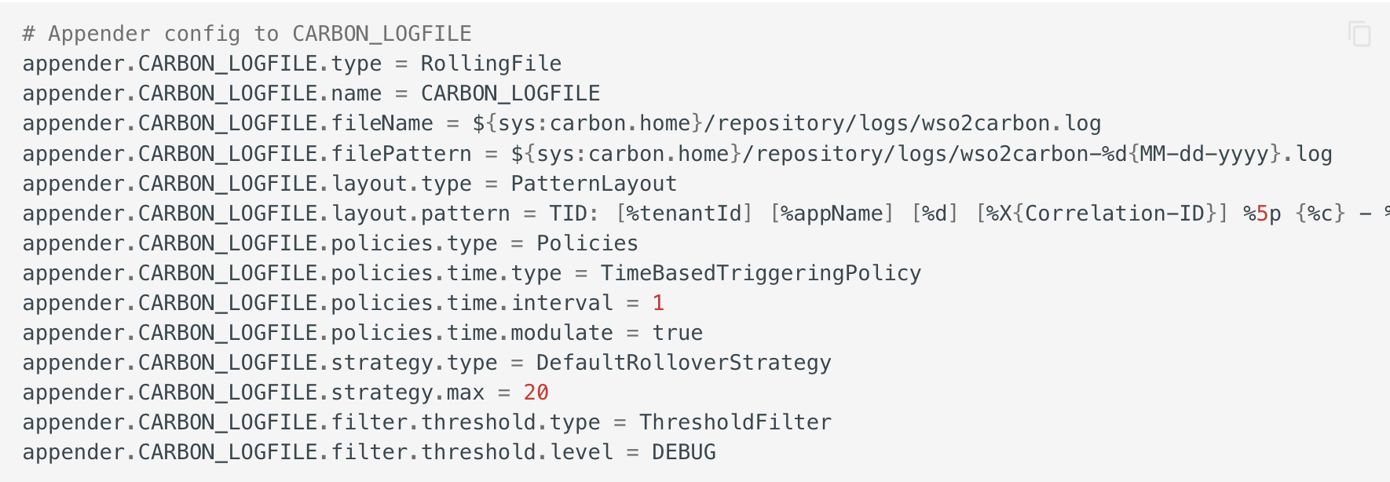
Configure Carbon logs
Carbon logs are enabled in WSO2 Identity Server by default. You can change the following default configuration by manually updating the log4j2.properties file.

Slide 14
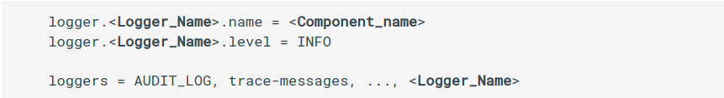
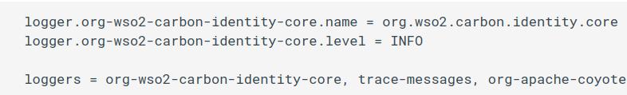
Enable logs for a component
Add a logger in the <IS_HOME>/repository/conf/log4j2.properties file to define the logger. Then, add the logger to the comma-separated list of loggers.

Slide 15
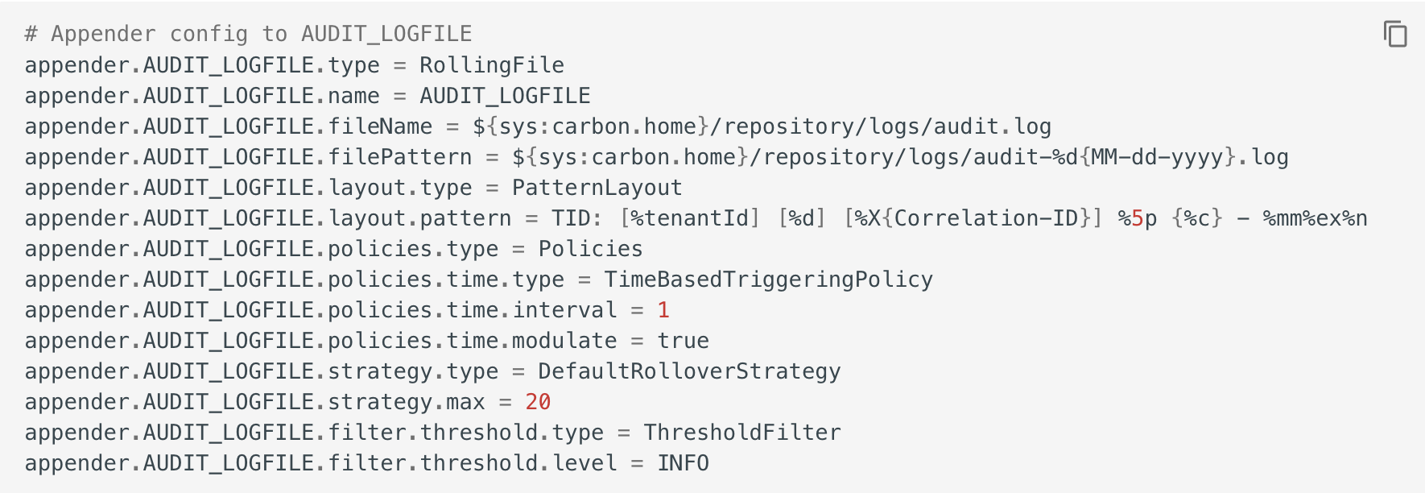
Configure Audit Logs
Audit logs are enabled in WSO2 Identity Server by default. You can change the default configuration by manually updating the the log4j2.properties file.

Slide 16
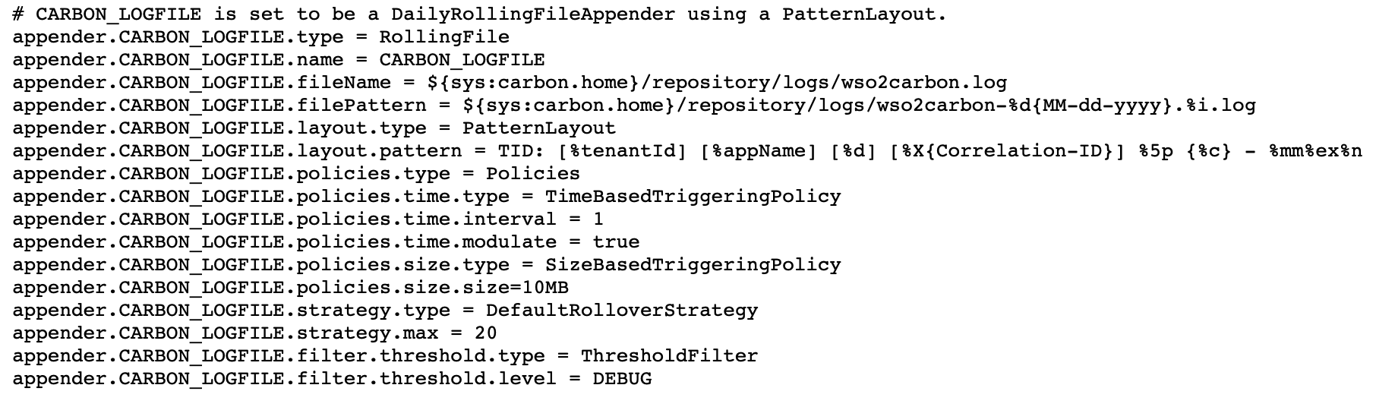
Configure Logs
Logs are configured in the log4j2.properties file.

Slide 17
Configure Logs
Logs are configured in the log4j2.properties file.

Slide 18
Configure Logs
Logs are configured in the log4j2.properties file.

Slide 19
Configure Logs
Logs are configured in the log4j2.properties file.

Slide 20
Configure Logs
Logs are configured in the log4j2.properties file.

Slide 21
Configure HTTP Access Logs
Configured in the deployment.toml file.
Learn more about log patterns in the DDocumentation.

Slide 22
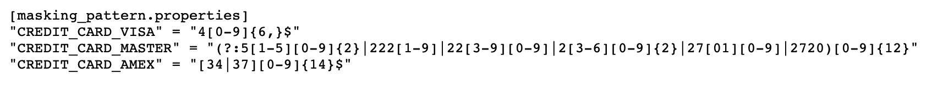
Mask Sensitive Information with Log4j
Mask the business-sensitive information from log files to avoid potential security breaches. Configured in the deployment.toml file. Logs matching the criteria are masked with ****.

Slide 23
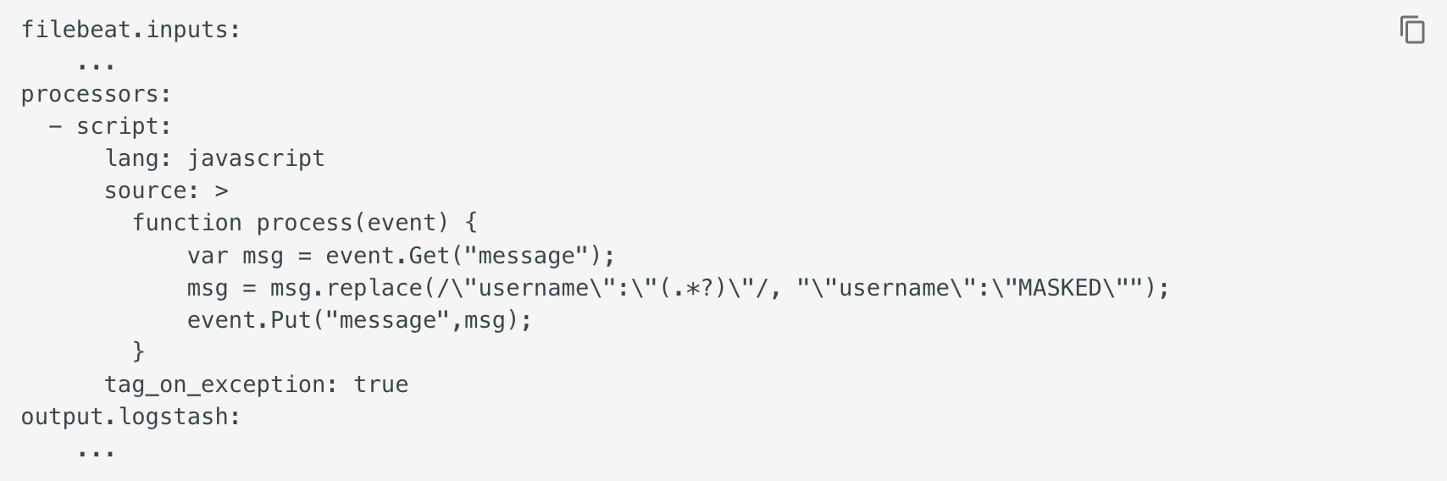
Mask Sensitive Information with Filebeats
Navigate to the home directory of your Filebeat installation and open the filebeat.yml file.
Add the following configuration after the filebeat.inputs section. Change the masking rules to fit your requirements.

Slide 24
Quick Recap

Slide 25

Log Types
Configure Logs
What you learnt

Slide 26



Any Questions ?
Reach us through the following channels
iam-dev@wso2.org
https://stackoverflow.com/questions/tagged/wso2-identity-server
https://discord.com/invite/Xa5VubmThw

Slide 27
Thank you!
Notes:
Acknowledge that it’s been a lot of changes within the team
Thank you for your taking onboard the feedback and being open to change.
A lot of work , a lot of learning, sometimes feeling twice the exhaustion
But also hopefully seeing what I see, which is: better ways of working, more innovation in our approach, more business acumen, more effective reactivity , more ahead of the game. Because that’s where marketing needs to be.
All this in a context where it’s also been a lot of changes for WSO2.
And from this standpoint I wanted to remind you of what Sanjiva said about you owning the culture

